Slide 1

Farm Market Tracker: Your Guide to Success
Welcome to the Farm Market Tracker, your all-in-one solution for managing your agricultural business.
FG
by Faith Chioma Godwin

Slide 2
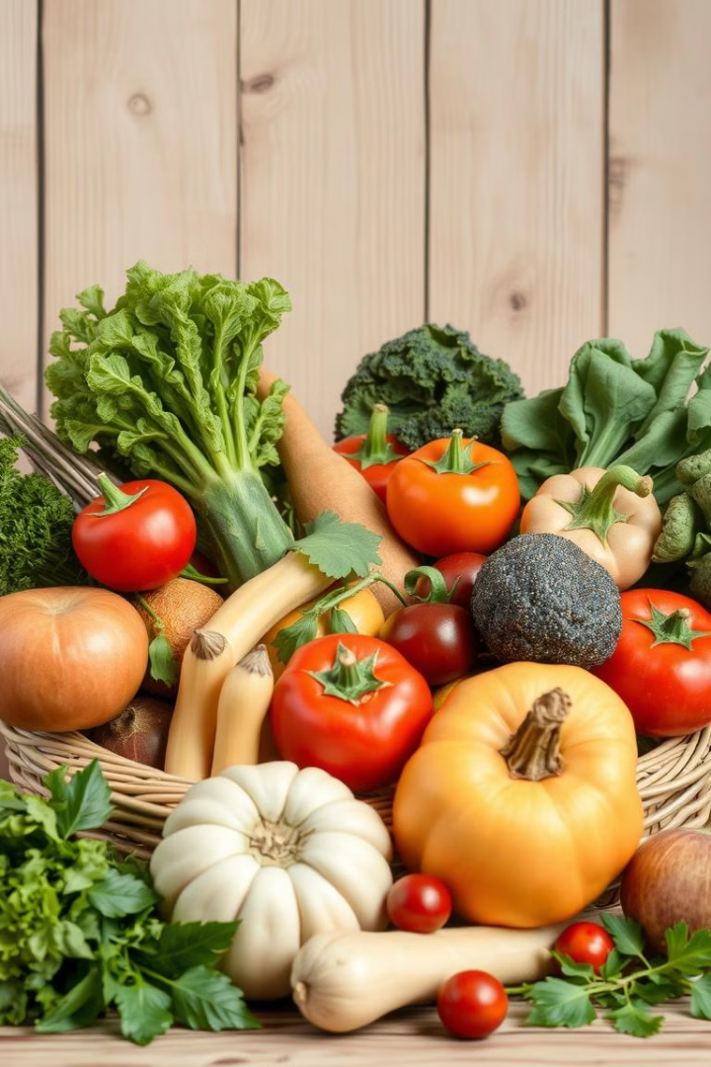
Maximize Your Harvest
1
Crop Types
Track the crops you cultivate, including their specific varieties and planting schedules.
2
Yields
Monitor your harvests, capturing data on quantity, quality, and any factors affecting yield.
3
Market Trends
Stay informed about the latest market trends and pricing fluctuations for your crops.

Slide 3

Uncover Local Market Opportunities
Local Demand
Pricing Insights
Understand the current demand for different crops in your region and identify potential gaps.
Access real-time pricing information from local markets, allowing you to set competitive prices for your products.
Market Networks
Connect with local buyers, wholesalers, and retailers through our integrated network.

Slide 4
Make Informed Decisions
Data Analysis
Market Intelligence
Strategic Planning
Gain valuable insights from historical data to predict future trends and optimize your farming practices.
Stay ahead of the curve by receiving alerts and notifications on important market updates and price changes.
Use the data to inform your planting decisions, adjust pricing strategies, and secure the best markets for your produce.

Slide 5




Increase Your Profitability
Maximize Yields
Produce higher yields through informed planting practices and optimized crop management.
Command Better Prices
Set competitive prices based on real-time market data and negotiate the best deals.
Reduce Costs
Minimize waste and optimize your resource allocation by understanding demand and market trends.

Slide 6
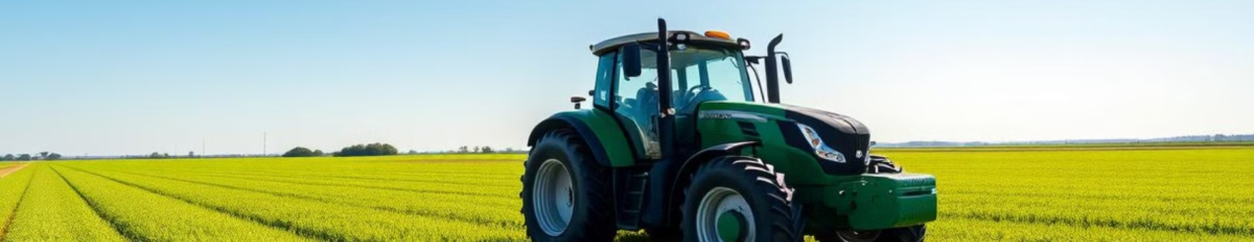
Streamlined Operations
1
Data Collection
2
Real-Time Updates
3
Centralized Platform
Capture data effortlessly with our user-friendly mobile application or web platform.
Stay connected to the latest market information and track your progress in real-time.
Manage all aspects of your agricultural business from a single, comprehensive platform.

Slide 7

Join the Farm Market Tracker Community
Network
Connect with other farmers, buyers, and industry experts.
Share Insights
Contribute to the collective knowledge base and learn from others.
Grow Together
Build a thriving community and work together to achieve success.

Slide 8
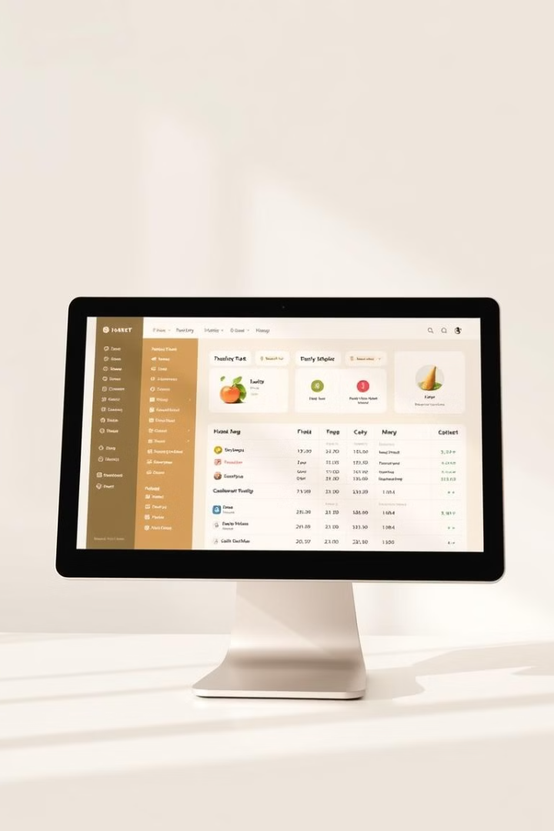


Start Your Journey Today
Sign Up
Schedule a Demo
Create your free account and start tracking your crops.
Learn how Farm Market Tracker can help you grow your business.

